Slide 1


Take Home Assignment Presentation for Data Analyst Position
LinkedIn: Mayank Dwivedi mayank-dwivedi-468873236
GitHub: CoderMayankD
HackerRank : HackerRank
By DA Mayank Dwivedi
Mobile No.: +91-8506938289
E-mail: mayankdwivedibb@gmail.com
Address: Noida
Date: 16-Jul-23

Slide 2





Overview
How are the efficiency numbers looking like? Can you share your views?
Which groups are quick slow etc. Create table + relevant charts.
What type of tickets are taking the most time to resolve? Create a table + relevance charts.
Create a different type of data rights weekend info from this data.
Shape of data
Data Variables
Data Types
Statistical Description of Data
Overall Analysis
Datatypes of variables
For “Priority”
For “Group”
For “Via”
For “Manual Tagging for Categories”
For “Status”
Resolution Time
Quickest tickets
Slowest Tickets
Categorical Insights
Conclusive Insights
Solutions to major problems found in EDA.
Problem Statements
Overall Dataset Description
Categorical Analysis
Insights
Closing Statements

Slide 3
Problem Statements
How are the efficiency numbers looking like? Can you share your views?
Which groups are quick slow etc. Create table + relevant charts.
What type of tickets are taking the most time to resolve? Create a table + relevance charts.
Create a different type of data rights weekend info from this data.

Slide 4
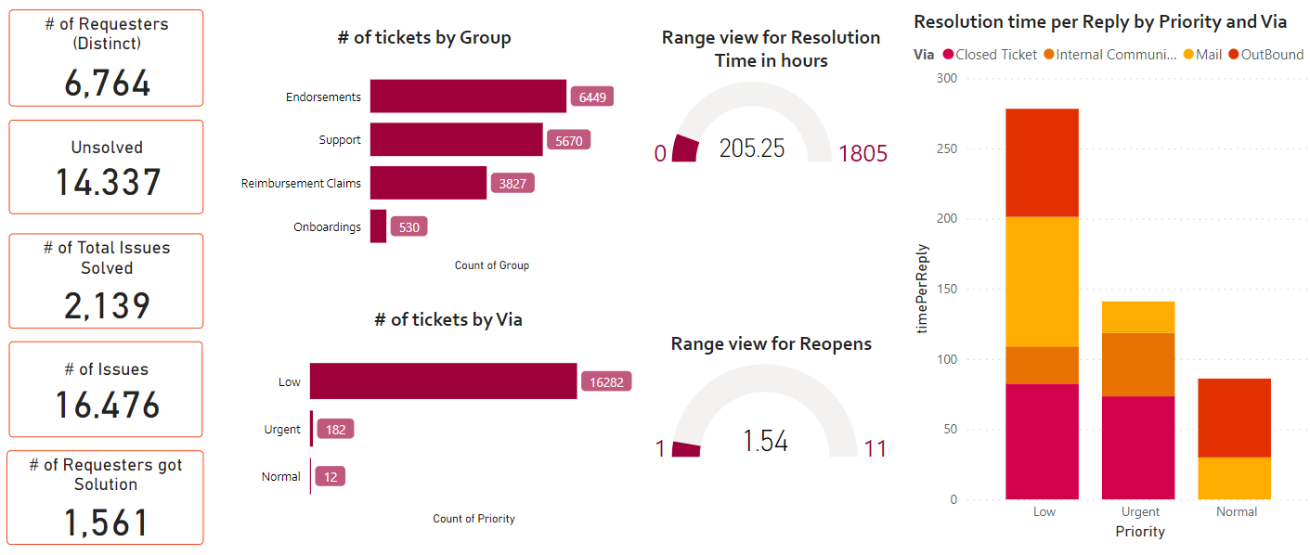
Overall Dataset Description

Slide 5
Overall Dataset Description: Datatypes of variables
Primary Key: Qualitative datatype- 'Id'
Numerical Type:
'Requester id’, 'Reopens', 'Replies', 'First reply time in minutes within business hours', 'First resolution time in minutes', 'First resolution time in minutes within business hours', 'Full resolution time in minutes', 'Full resolution time in minutes within business hours', 'Requester wait time in minutes', 'Requester wait time in minutes within business hours',
Temporal Type : Datetime -
'Created at', 'Initially assigned at', 'Assigned at', 'Solved at', 'Updated at'
Categorical Type : Datetime -
'Group', 'Status', 'Priority', 'Via', 'Resolution time', 'Satisfaction Score', 'Manual Tagging of Categories'

Slide 6

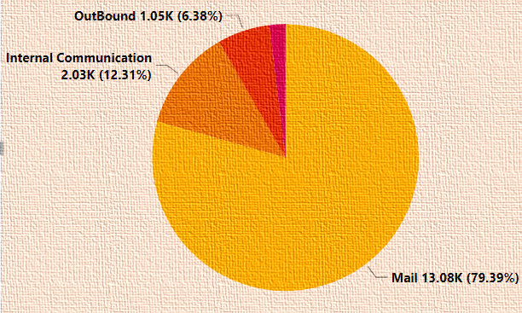
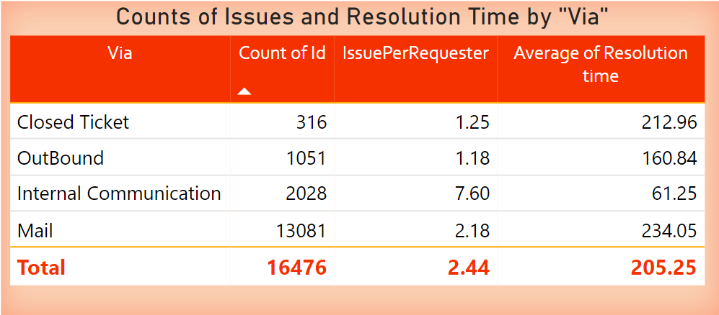
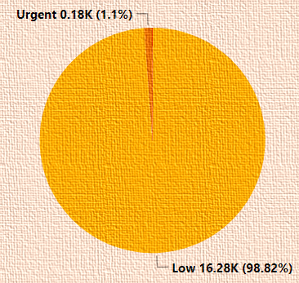
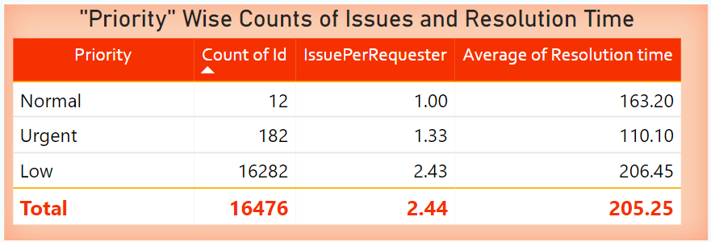
Categorical Analysis
By Priority: More than 98% of tickets were made with Low Priority

Slide 7
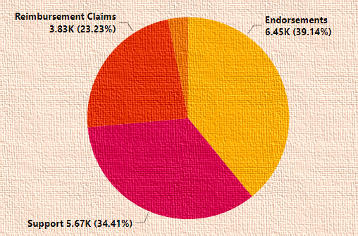
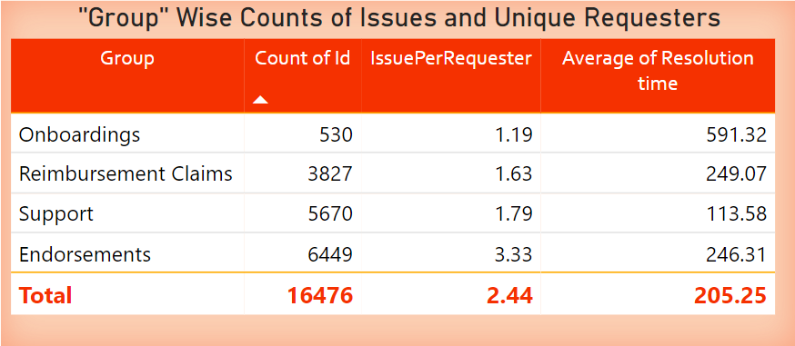
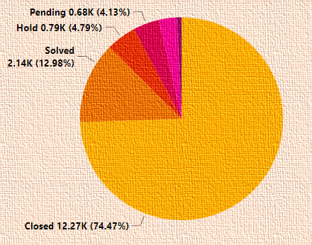
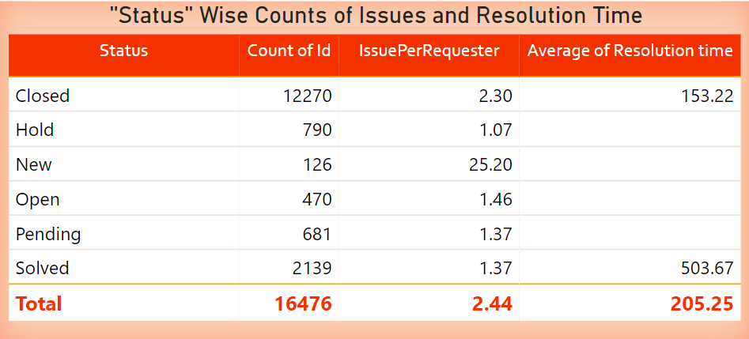
Categorical Analysis
By Group: Highest load is over Endorsements Group tickets whereas least load is over Onboardings Group tickets.
By Status: Endorsements Group has most Solved ~40% of Total Solved tickets (2139).

Slide 8
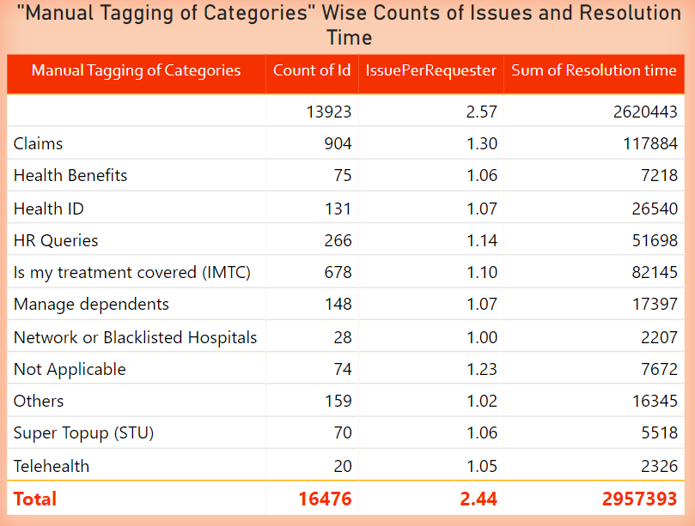
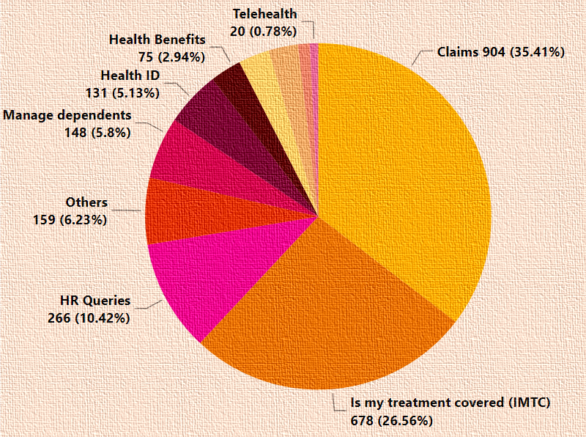
Categorical Analysis
Here a Blanks have been filtered out because of it huge count of 13923 out of 16476 total counts in all categories.

Slide 9
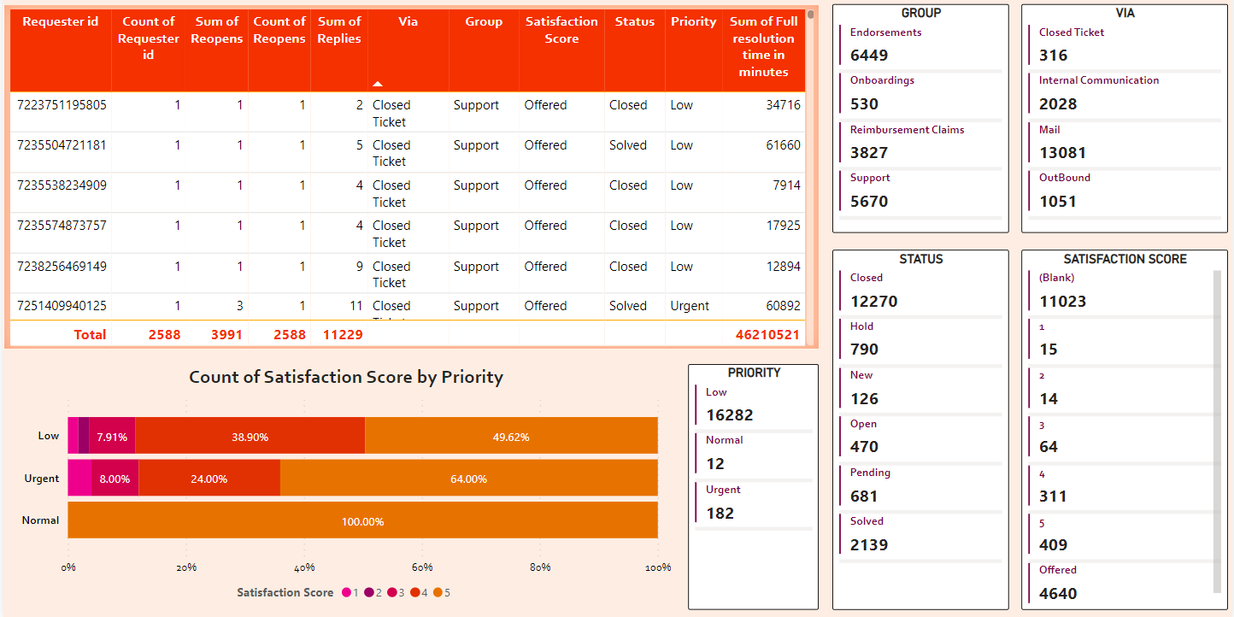
Insights Dashboard showing all the categorical variables from Dataset with the interactive table made in Power BI

Slide 10
Insights: Efficiency Numbers as Solved Tickets
Percentage of solved tickets within each Manually Tagged Categories:
Category “Claims” has Solved 9.6% of all the tickets which were tagged in that category.
Category "IMTC” has Solved 8.99% of all the tickets which were tagged in that category.
Category "HR Queries“ has Solved 13.64% of all the tickets which were tagged in that category.
Category "Health ID“ has Solved 13.82% of all the tickets which were tagged in that category.
Category "Management Developments” has Solved 11.9% of all the tickets which were tagged in that category.
Category "Not Applicable” solved 14.94% of all the tickets which were tagged in that category.
Category “Others“ solved 7.02% of all the tickets which were tagged in that category.
Category "Health Benefits“ has Solved 12.79% of all the tickets which were tagged in that category.
Category "SuperTopUp” has Solved 13.58% of all the tickets which were tagged in that category.
Category “Network and Blacklisted Hospitals” has Solved 3.45% of all the tickets which were tagged in that Category.
Category "TeleHealth“ has Solved 4.76% of all the tickets which were tagged in that category.

Slide 11
Insights: Efficiency Numbers as Workload
Rank 1. Onboardings
Rank 2. Support
Rank 3. Endorsements
Rank 4. Reimbursement Claims

Slide 12
Insights: Efficiency Numbers as Solved Tickets
Rank 1. Not Applicable
Rank 2. Health ID
Rank 3. HR Queries
Rank 4. Super Topup (STU)
Rank 5. Health Benefits
Rank 6. Network or Blacklisted Hospitals
Rank 7. Telehealth
Rank 8. Others
Rank 9. Is my treatment covered (IMTC)
Rank 10. Manage dependents

Slide 13
Insights: Efficiency Numbers as Solved Tickets
Percentage of solved tickets within each Manually Tagged Categories:
Category study with respect to the reply time:
“Normal” priority tickets tagged under “Is My treatment Covered (IMTC)” has very significantly quickest resolution time per reply 1.23hours followed by claims categories with 1.80 hours of resolution time per reply, whereas tickets with “Urgent” priority has quickest time under the category which are not tagged manually 45.51 hrs of resolution time to solve under urgent and hence it can be called the quickest among all other category.
Categories: “Network or Blacklisted Hospitals”, “Category”, “Health Benefits”, “Is My treatment Covered (IMTC)” and “Others” have nearly similar resolution time in low priority tickets whereas tickets which were never tagged Untagged has highest resolution time for low priority ticket with 94.75 hours resolution time per reply.
There was a need to create a measure having Resolution Time per Reply.
DAX Expression was :
timePerReply = CALCULATE(DIVIDE(SUM(Table_Table1[Resolution time]),SUM(Table_Table1[Replies])))

Slide 14
Insights Efficiency Numbers as Resolution Time Tickets
About the Dashboard
These are the funnel charts made on Power BI for different variables and their time per reply
Data: Respective Column Names
Values:
Resolution Time Per Reply
Microsoft Power BI
Quickest and Slowest route of solving tickets.
Via “Internal Communication” it takes only 28.17 hrs. of resolution time per reply, where as via mail it takes 92.21 hrs. of resolution time per reply i.e. that implies “Internal communication” is Fastest and “Mail” is Slowest route of solving ticket.
It has been noticed that “Internal Communication” route of replies has more than 3x faster resolution time per reply as compared to the slowest (Via Mail).

Slide 15
Insights: Efficiency Numbers as Reopened Tickets
Efficiency Number as number of reopened tickets deriving the rank of best to worst efficient Group as :
Rank 1. Onboardings
Rank 2. Endorsements
Rank 3. Reimbursements Claims
Rank 4. Support

Slide 16
Insights: Efficiency Numbers as Reopened Tickets
Rank 1. Closed Tickets
Rank 2. OutBound
Rank 3. Internal Communication
Rank 4. Mail

Slide 17
Insights Efficiency Number as Resolution time
Rank 1. Internal Communication
Rank 2. OutBound
Rank 3. Closed Ticket
Rank 4. Mail

Slide 18
Insights Efficiency Number as Resolution time
Resolution time per reply by status:
“Urgent” priority tickets which where solved with more than 2x resolution time per reply as compared to time taken by average of all total urgent priority tickets resolution time per reply.
i.e. urgent priority - resolution time per reply 45.70 hrs. and urgent with solved status has 109.09 hrs.
It has been noticed that urgent ticket with the closed status has better resolution time with respect to most of the urgent ticket i.e. 41.12.
It has been noted that in general its taking double time in Solving the ticket then to Closing the ticket.

Slide 19
Insights Quickest and Slowest Fields by Resolution time
Quickest and Slowest route of solving tickets.
Via “Internal Communication” it takes only 28.17 hrs. of resolution time per reply, where as via mail it takes 92.21 hrs. of resolution time per reply i.e. that implies “Internal communication” is Fastest and “Mail” is Slowest route of solving ticket.
It has been noticed that “Internal Communication” route of replies has more than 3x faster resolution time per reply as compared to the slowest (Via Mail).

Slide 20

Closing Statements and Conclusion
Quickest and Slowest Priority tickets :
Q. Do they actually act like they are mentioned in Priority category?
“Urgent” priority tickets which where solved has more than double resolution time per reply as compared to time taken by avg of all total urgent priority tickets resolution time per reply.
i.e. urgent priority - resolution time per reply 45.70 hrs. and urgent with solved status has 109.09 hrs.
It has been noticed that urgent ticket with the closed status has better resolution time with respect to most of the urgent ticket i.e. 41.12.
They are taking double time in solving the ticket then to close the ticket.

Slide 21
Closing Statements and Conclusion
Q. Which Group needs to be focused more to handle the rush?
As per dataset “Mails” received ~80% of the tickets which are majorly received by Support group so company should increase work force there.
As per manual tagging in categories most of the tickets Over under cleans category hence it is inferred that others also must be majority in the claim category so workforce should be aligned towards claim solving grouping.
According to data it is very clear that 98.82% of tickets are of low priority Tickets because of .
It is important to note that Approximately 73.43% of tickets are being closed and only 12.47% tickets are being solved in the Status variable.
It is very clear that there are about 16,476 tickets raised in total dataset but there are only 6 764 distinct ids that means there are so many people who are reopening their requests as tickets company should focus on reducing the reopening rate. Talking about reopening support group has about 47.38% of reopening whereas reimbursement claims has 38.76% and followed by endorsement and onboarding which has 3% of reopening this signifies that support group has so many reopening which may is another cause of increasing work load.

Slide 22
Closing Statements and Conclusion
Talking about reopen tickets through “Mail” route as about 77.54% of reopen tickets that i.e.,” Mail” as route should be maintained very nicely to handle the rush.
About Satisfaction Score: Studying the data by Group, It is very clear that only support group got the satisfaction school whether it be 1,2,3,4,5 or offered Whereas reimbursement claims onboardings and endorsements got no satisfaction scored which should be noted down because satisfaction score is very important to judge efficiency of any department or category.
According to the data of satisfaction score by priority it is very clear that low priority tickets are getting all the variety of satisfaction score 1 to 5 whereas normal tickets only got only 5 rating. It is very clear that 64% of urgent priority tickets got five rating and 24% of them got four rating so it can be computed that urgent tickets are being solved at a good score of satisfaction. A similar kind of pattern can also be seen in low priority tickets where 50% tickets are getting sold with five ratings and 39.90% of tickets are getting solved with four rating and another 8% tickets are getting solved with three date that implies a load priority tickets are also being solved with good score but it should not be ignored that satisfaction score is not given to each and every ticket. But it should not be ignored that majority of the data does not have satisfaction score .
Company should walk upon getting the satisfaction score even whether it is any status closed salt pending new or on hold.

